Slide 1
Web Application Development With Java CEJV 559
Distributed Version Control

Slide 2
Centalized Version Control
Centralized VCS emerged from the 1970s, when programmers had thin clients and admired “big iron” mainframes
Centralized is simple
A single place everyone can check in and check out
Works for backup, undo and synchronization
Isn’t great for merging and branching changes people make
Distributed systems make branching and merging painless because they rely on it

Slide 3
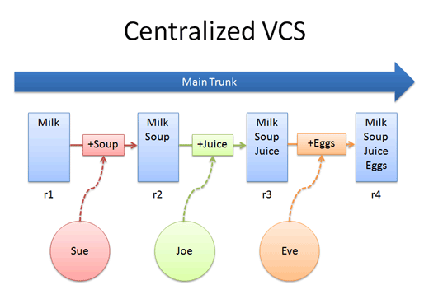
Centralized VCS

Slide 4
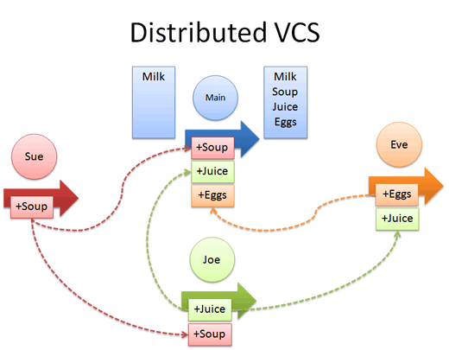
Distributed Version Control Systems
In a distributed model, every developer has their own repo.
If desired, everyone can push changes into a common repo

Slide 5
Core Concepts
Centralized version control focuses on synchronizing, tracking, and backing up files.
Distributed version control focuses on sharing changes
every change has a guid or unique id
Distributed systems have no forced structure.
You can create “centrally administered” locations or keep everyone as peers.

Slide 6
New Terminology
push
send a change to another repository (may require permission)
pull
grab a change from a repository

Slide 7
Key Advantages
Everyone has a local sandbox.
You can make changes and roll back, all on your local machine.
No more giant checkins; your incremental history is in your repo.
It works offline.
You only need to be online to share changes.
It’s fast.
Diffs, commits and reverts are all done locally.

Slide 8
Key Advantages
It handles changes well.
Distributed version control systems were built around sharing changes.
Every change has a guid which makes it easy to track.
Branching and merging is easy.
Because every developer “has their own branch”, every shared change is like reverse integration.
The guids make it easy to automatically combine changes and avoid duplicates.

Slide 9
Key Advantages
Less management.
Distributed are easy to get running
There’s no “always-running” server software to install.
DVC may not require you to “add” new users; you just pick what URLs to pull from

Slide 10
Key Disadvantages
You still need a backup.
With a DVCS, you still want a machine to push changes to “just in case”.
In Centralized VCS you usually dedicate a machine to store the main repo
Do the same for a DVCS.

Slide 11
Key Disadvantages
There’s not really a “latest version”.
If there’s no central location, you don’t immediately know who to see for the latest version.
A central location helps clarify what the latest “stable” release is.

Slide 12
Key Disadvantages
There aren’t really revision numbers.
Every repo has its own revision numbers depending on the changes.
Instead, people refer to change numbers:
Pardon me, do you have change fa33e7b?
Remember, the id is an ugly guid.
You can tag releases with meaningful names.

Slide 13
Bibliography
http://betterexplained.com/articles/intro-to-distributed-version-control-illustrated/

